Slide 1

Object Orientated Software Engineering
Finding Bugs in Software
By Stephen Lindsay

Slide 2
Outline
What is a Bug?
What causes Bugs?
How do we measure Software reliability?
How much do bugs cost?
How do we manage bugs?

Slide 3
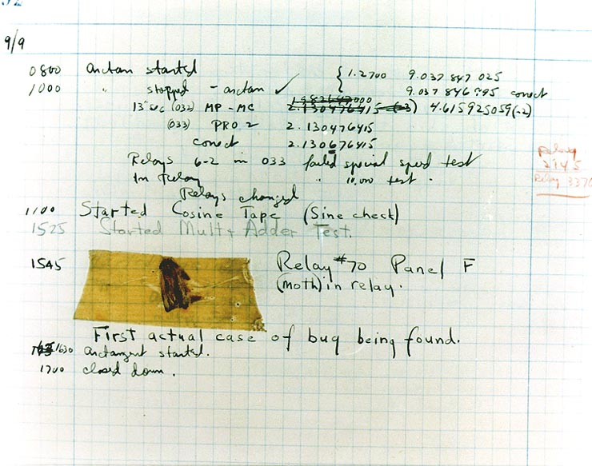
Outline

Slide 4
Bugs are everywhere
Intel Pentium Floating-Point Division Bug
Enter the following equation into your PC's calculator:
(4195835 / 3145727) * 3145727 – 4195835
If the answer is zero, your computer is just fine.
If you get anything else, you have an Intel Pentium CPU with a floating-point division bug

Slide 5
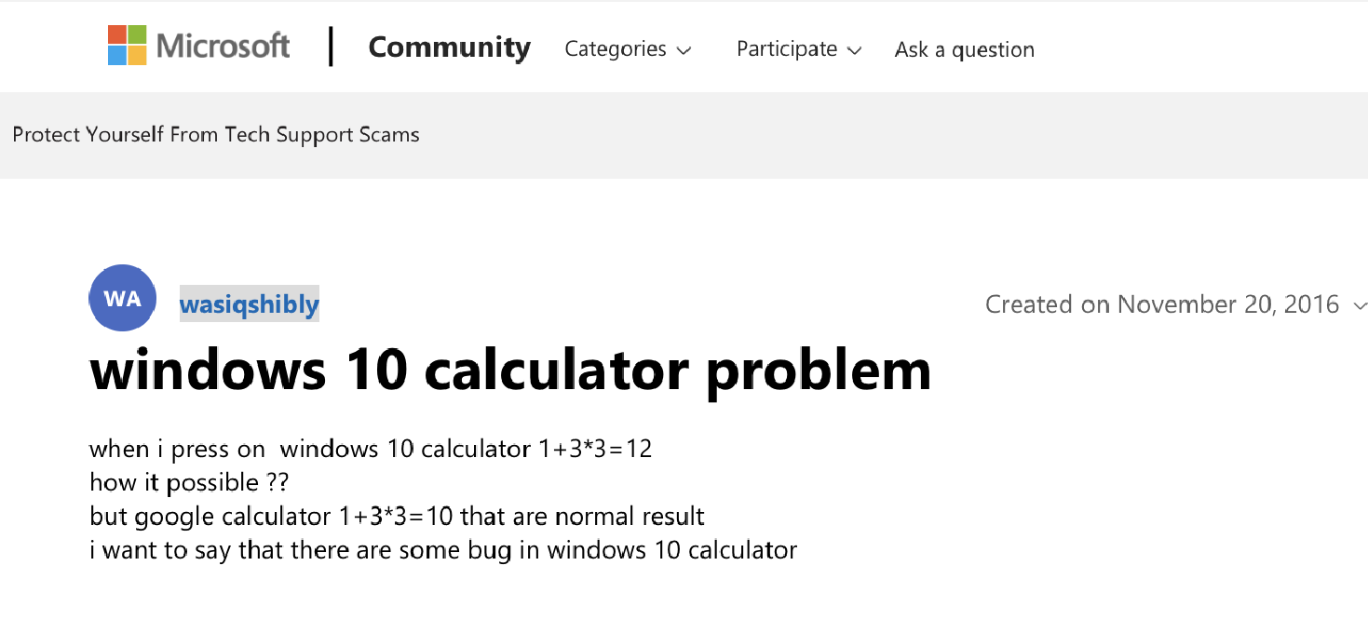

Slide 6
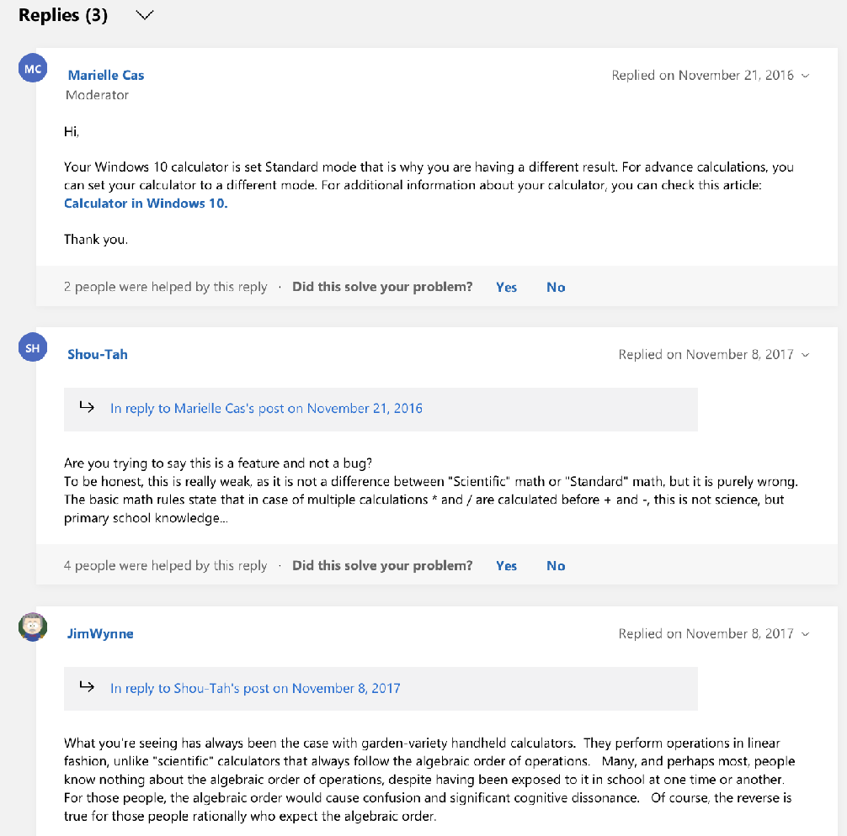

Slide 7
Strict Definition of Software Bugs
A common term used to describe a flaw, mistake, or failure in a computer system that produces an incorrect or unexpected result or causes it to behave in unintended ways.
Everything we don’t like is a bug – is that helpful? We can also think of bugs as symptoms or clues – they show us that something about what we have built isn’t working how we think it should
With this perspective, bugs are quite important to us because they can clue us in to much larger problems

Slide 8
What is a bug
A software bug occurs when one or more of the following five rules is true:
The software doesn't do something that the product specification says it should do.
The software does something that the product specification says it shouldn't do.
The software does something that the product specification doesn't mention.
The software doesn't do something that the product specification doesn't mention but should.
The software is difficult to understand, hard to use, slow, or—in the software tester's eyes—will be viewed by the end user as just plain not right.

Slide 9
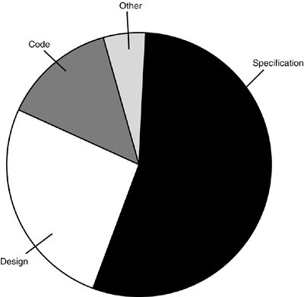
The cause of bugs – Bad Specification
Let’s try looking at the cause of bugs instead to see if that’s more useful
The number one cause of software bugs is the specification, why?
Unwritten or incomplete
Ambiguous
Constantly changing
Not communicated to the development team

Slide 10
The cause of bugs – Design
The next large source of bugs is design:
Inappropriate modelling
Lack of modelling tools
Time to market pressure
Developers frequently don’t consider design an important step – this leads to inappropriate consideration of design choices and the alternatives.

Slide 11
The cause of bugs – Coding
Coding errors:
Software complexity
Poor documentation
Limited time
Programmer skills
If it’s only the third most common reason, why focus on it?
Foundational element of the work
Probably still a common cause for some of us!

Slide 12
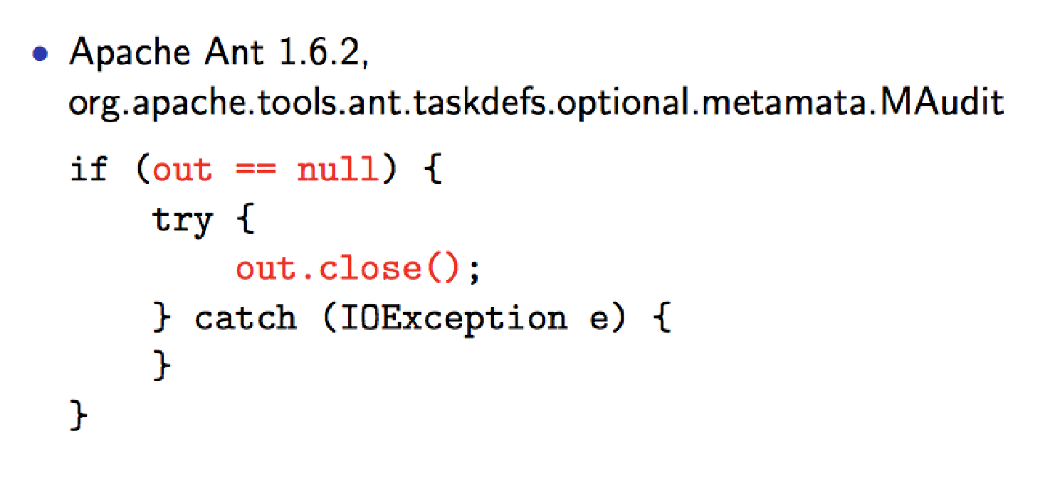
Bugs causes in code

Slide 13
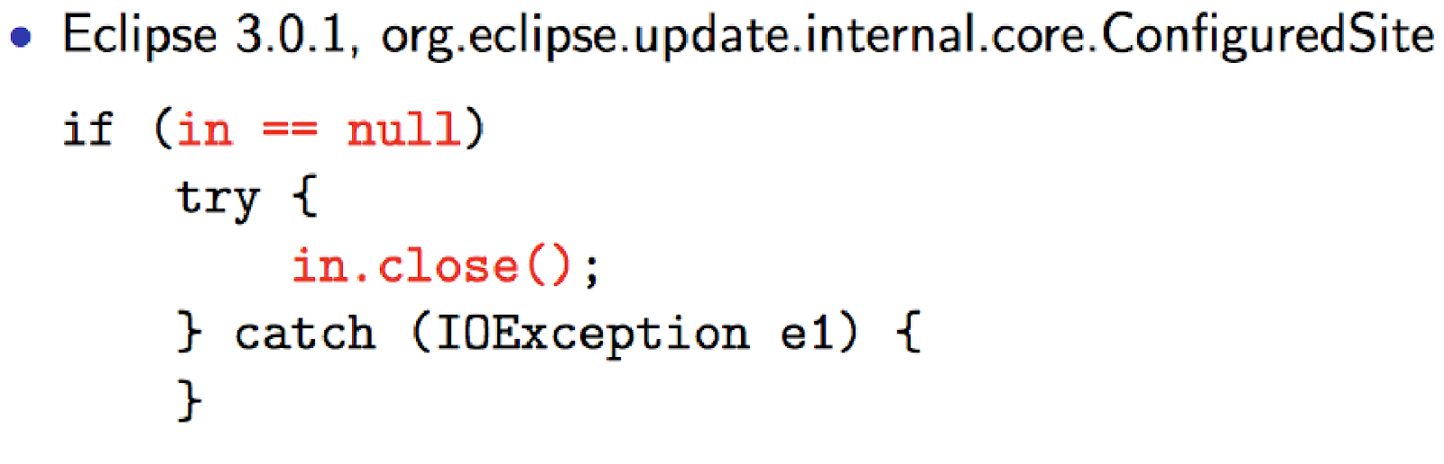
Bugs causes in code

Slide 14
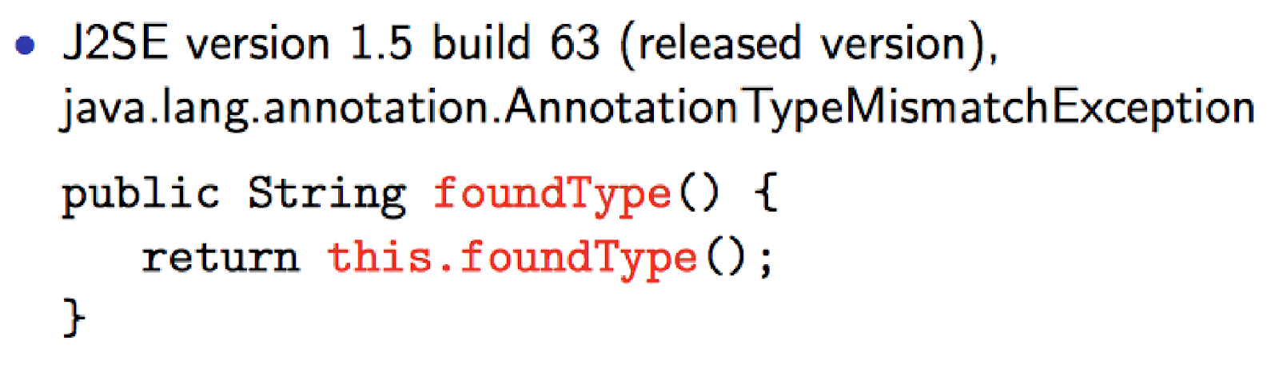
Bugs causes in code

Slide 15
Typical coding mistakes
Improper use of class library
Inheritance implementation error
Wrong message
Wrong object
Override error
Data flow error
Misuse local variable
Scope boundary error
Domain knowledge
Algorithm error
Need refactoring
Missing operation
Unnecessary code
Syntax error

Slide 16
Software Reliability
The probability of failure-free software operation for a specified period in a specified environment
It denotes a product’s reliability and impacts customer satisfaction or retention.
Banking - unreliable behaviour in banks is not ideal!
Video games - ever tried to play a multiplayer game and the servers were down?
Healthcare – obviously, safety critical systems!

Slide 17
Software Reliability
Software’s unreliability is not caused by aging but is due to bugs
The more bugs, the less reliable the software is likely to be!
However, failures seem random, hence Bayesian (probabilistic) theories over time are applied
R(t) - the probability of software still functioning at a given point in time (t)
Availability/up-time - what percentage of the time will a service be available (particularly useful in online services)
Mean time between failures (MTBF) - how long, on average, will you go before the system fails again

Slide 18
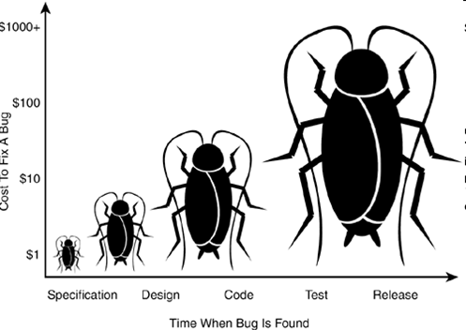
The cost of bugs
The cost of bugs grows logarithmically as they go uncaught
Most forms of testing only find about 1 bug out of every 3. And all tests together barely remove 85% of bugs during testing
Even the best companies and organizations have released products with expensive (but sometimes simple to fix) bugs

Slide 19
Bug tracking workflows
A tester finds a bug and reports it
The bug is assigned to a manager for initial triage
The manager resolves it or assigns it to a developer
Resolved bug is returned to a tester
The tester either closes the bug or reopens it with additional information or comments which start step 2 again
Users and developers report bugs, to allow software developers to fix them
Bug reports are added to an issue tracking system or bug repository (Apache Bloodhound, Bugzilla, Jira, Trac, etc.)

Slide 20
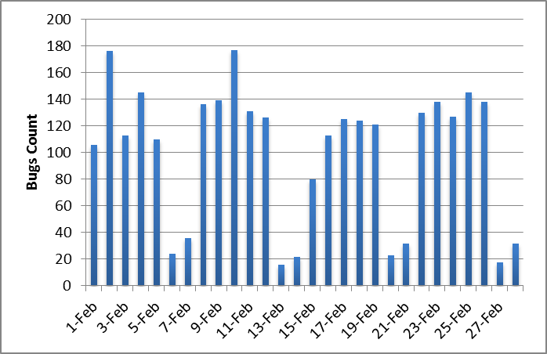
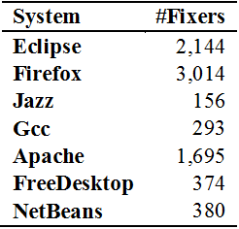
Bug triaging
Bug triaging: Assigning a bug to the most appropriate/capable developer to address it.
The triager analyzes, and assigns bug fixers for each new bug prioritising based on seriousness
Effective bug triage needs:
Knowledge about the system/project
Descriptive bug reports
Good rates of reporting of bugs
Coordination with developers on different projects and with various specialties

Slide 21

Software testers goals
… to find bugs
… as early in the software development processes as possible
… and make sure they get fixed.
Advice: Be careful not to get caught in the dangerous spiral of unattainable perfection:
You know you are finished when the only bugs left are the ones that you decide you can live with at least for now!
–Robert Sabourin, I am a Bug

Slide 22
Summary
What is a Bug? – Definition as a problem vs. utility as a symptom.
What causes Bugs? – Code, design and spec issues.
How do we measure Software reliability? – Because we never get 100%
How much do bugs cost? – It depends when we find them.
How do we manage bugs? – With bug tracking and a carefree outlook!

